Slide 1
FluAntigenMatch_Outcome project update

Slide 2
Estimating state-specific antigenic match between vaccine vs. circulating viruses
Download a recent 12-year H3N2 HA tree from nextstrain.org
For each season between 2010-2011 through 2019-2020
  Find the vaccine strain that was available that based on WHO’s website
  Find the clades that were circulating in the USA that season from GISAID
  Count the number of sequences per clade and state from GISAID for virus isolates collected during the season (Seasonal cycle is defined as the sample collection period from 08/01 to 07/31 in the following year)
  Calculate clade frequencies per state from the count data
  For each clade, find the amino acid substitutions on the path between the clade’s most ancestral node in the 12-year tree and the vaccine strain from that season.
  In the table of antigenic effects per season ending in October or April, find the closest timepoint to your current season and load the effects per mutation from that timepoint (including mutations in HA1, HA2, and SigPep)
  For each vaccine/clade pair, sum the antigenic effects associated with the mutations found on the path between the vaccine and clade nodes in the tree. This gives you the antigenic distance between vaccine and clade for the season.
  For each state, calculate the weighted antigenic distance from the vaccine strain weighting the antigenic distance per clade by the frequency of the clade in the state.

Slide 3
Fixing errors in reading AA substitutions between vaccine and its MRCA
Fixing this error did not change the result as reversed reading of AA substitution between vaccine and its MRCA did not have any antigenic weight.

Slide 4
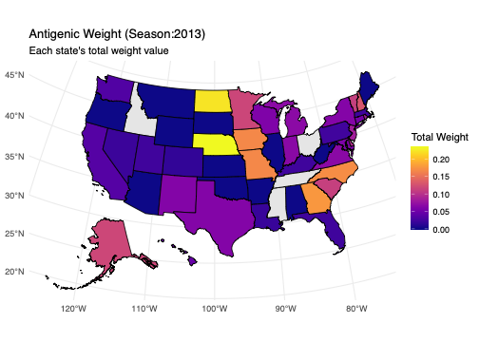

Using only April-timepoint for weight calculation
Before fixing reversed AA reading error
After fixing reversed AA reading error

Slide 5
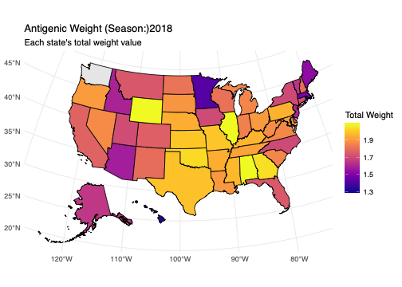

Using only April-timepoint for weight calculation
Before fixing reversed AA reading error
After fixing reversed AA reading error

Slide 6
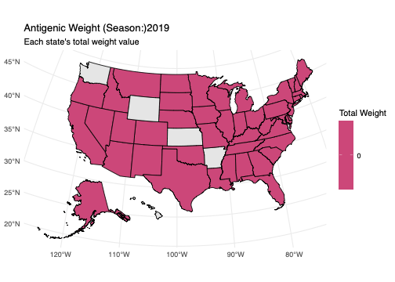

Using only April-timepoint for weight calculation
Before fixing reversed AA reading error
After fixing reversed AA reading error

Slide 7
Using antigenic weights calculated in October (beginning of the season) vs. April (end of the season) time points
Estimated state-level average vaccine’s antigenic match using per-mutation weight calculated in two different time points: October vs. April
Overall, using early-season weight information makes the antigenic match look worse (higher average antigenic weight per state)
For 2019, using October timepoint allows to restore some missing weight information in April weight data (see the graph for 2019 season on page 11)
Please note that the relative frequency of circulating viruses from GISAID was calculated based on the season definition of period from 08/01 to 07/31 in the following year. Hence, the period used for frequency calculation does not match with the period that weight is calculated. Therefore, the map in the following slides should NOT be interpreted as “antigenic match in the beginning of season”. We are simply comparing the mapping using two different weight data.

Slide 8
Using antigenic weights calculated in October (beginning of the season) vs. April (end of the season) time points
Question: Are the October time-point data intended to represent a snapshot at that time, or are they generated from data accumulated up to October (which would overlap with the April data)? Since weight information available in October is not available in the following April, I am assuming the October dataset is a snapshot. If so, how should we combine the April and October data within the same season?

Slide 9
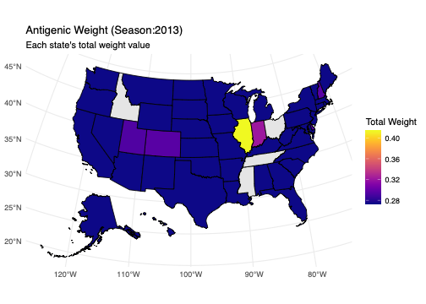
Using April vs. October-timepoint for weight calculation
April
October

Slide 10
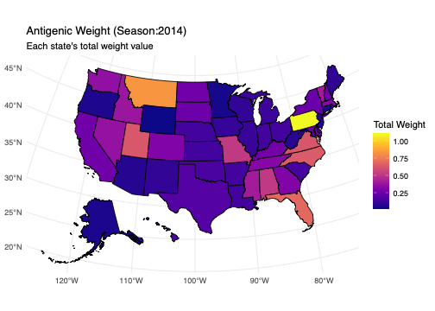
Using April vs. October-timepoint for weight calculation
April
October

Slide 11
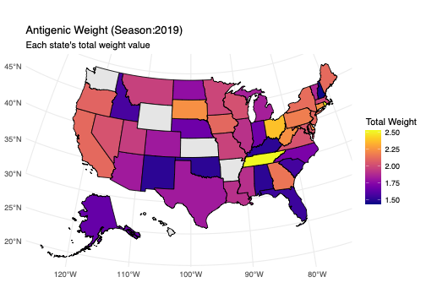
Using April vs. October-timepoint for weight calculation
April
October

